Slide 1
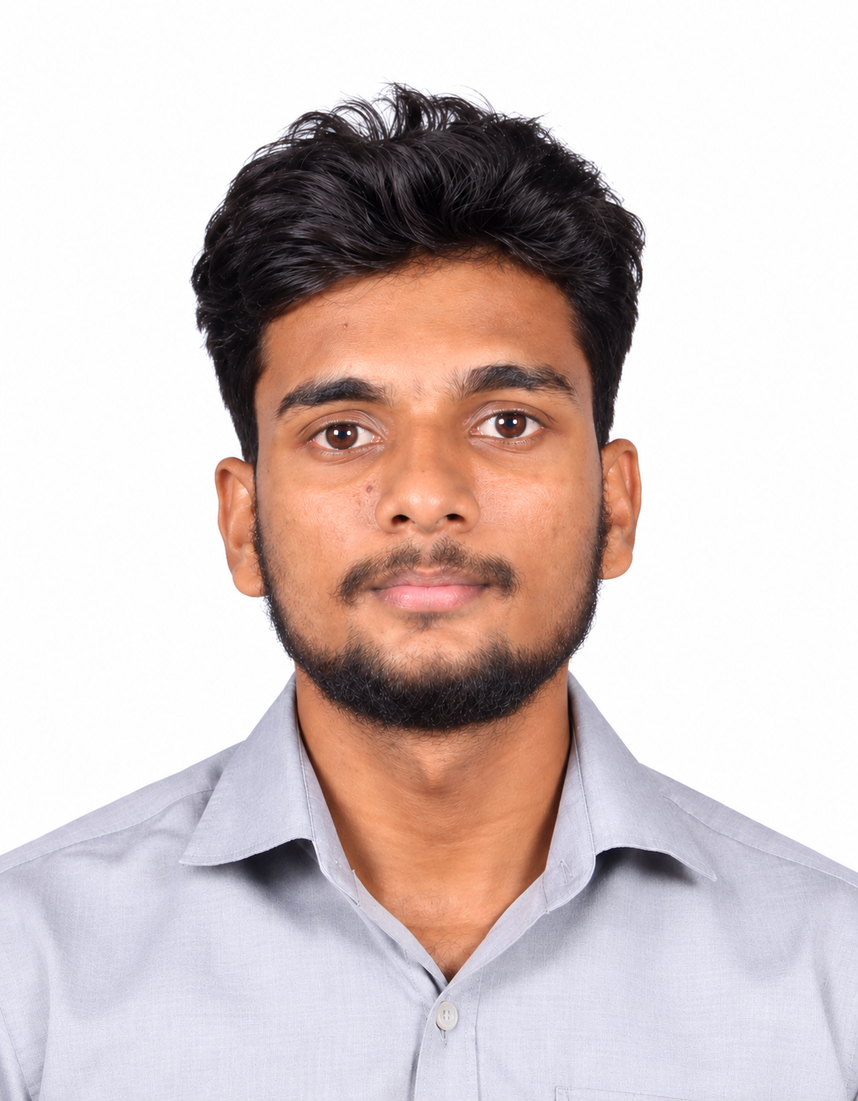
MS/EAC11-EM
Sanjay S
Software Engineer Intern
Final-year student at VIT Vellore, spending the last year of my programme here as an intern. Looking forward to work on real projects and learning from the team.
About Me
Solo traveller and football player, always up for a new place or a match.
PROGRAMME
Integrated M.Tech, Software Engineering · VIT Vellore · Final year
My Journey
Python & Java
Web & APIs
Cloud & DevOps
Agentic AI
From VIT Vellore to a year in industry. Excited to learn from the team.

